Slide 1
DDS Analytics client case study
Aaron Abromowitz

Slide 2
CONTENTS
Introduction
Exploratory Data Analysis (EDA)
Predicting Attrition
Predicting Monthly Income
Conclusion

Slide 3
Introduction
Employee Dataset
36 Total Fields
870 Entries
Fields of Interest
Categorical: Attrition
Numeric: Monthly Income
Predictions
High Sensitivity
High Specificity
Low Root Mean Squared Error (RMSE)
Variable Type | Count
Categorical | 18
Numeric | 18
Total | 36

Slide 4
Looking at dataset
No Missing values
Removed 5 variables
2 Identification variables
3 Variables with only one value
8 Categorical Variables with words
9 Categorical Variables with numbers
7 of these variables have meanings for the numbers
Variable Type | (New) Count
Categorical | 17
Numeric | 14
Total | 31

Slide 5
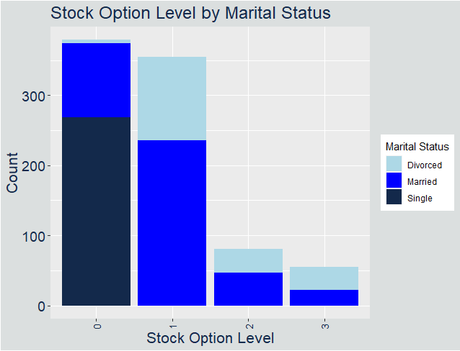
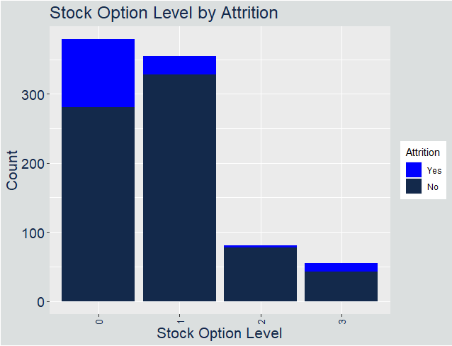
Interesting Observations: Marital status vs Stock Option Level
All Single People have Stock Option Level 0
Addressing could affect Attrition

Slide 6
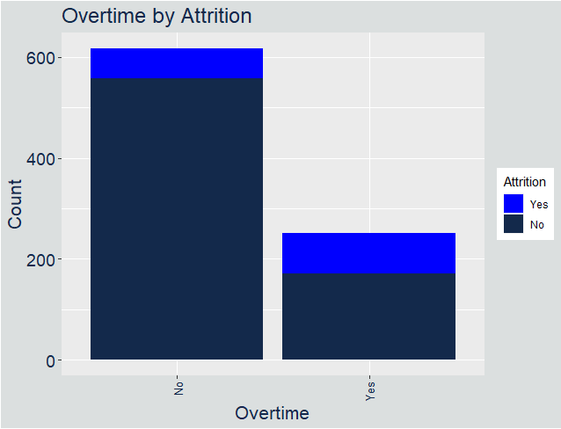
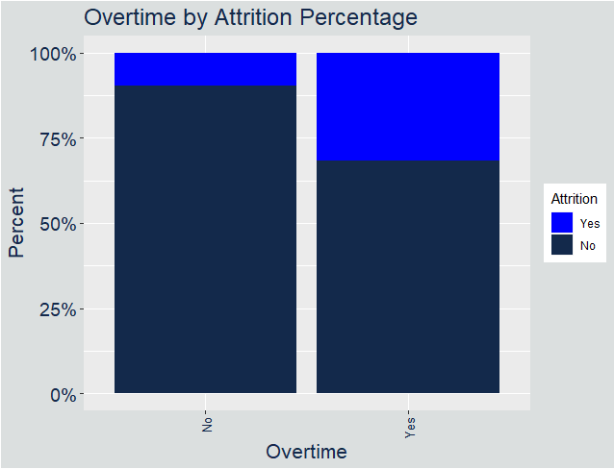
Interesting Observations: Overtime vs attrition
People who work overtime are far more likely to leave the company

Slide 7
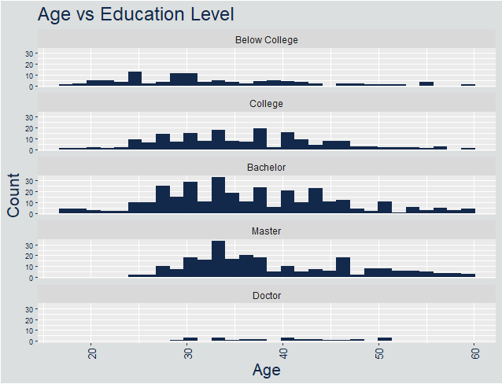
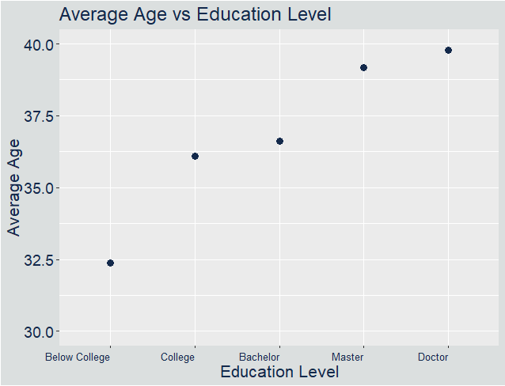
Interesting Observations: age vs education
Age increases with Education
Missing out on younger Masters and Doctors

Slide 8
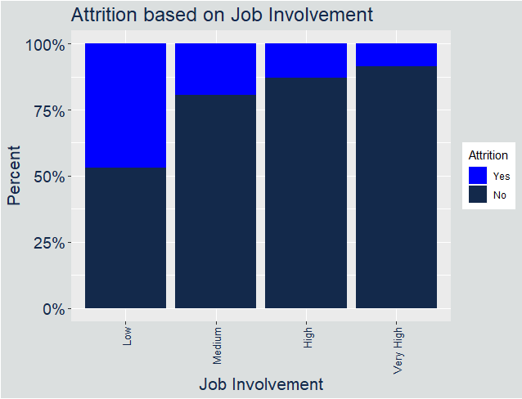
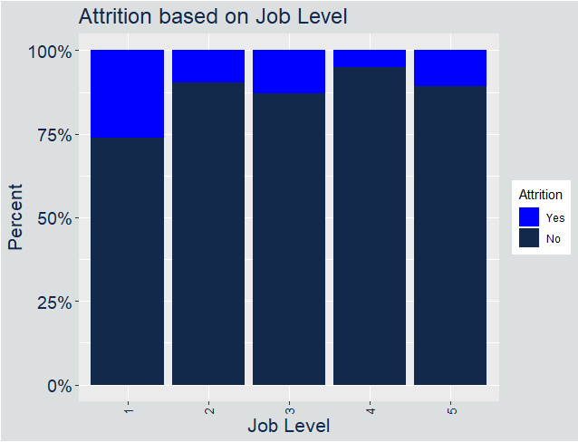
Variables related to attrition: Categorical
Evidence of strong relationship between Attrition and Job Involvement
Attrition seems related to Job Level of 1

Slide 9
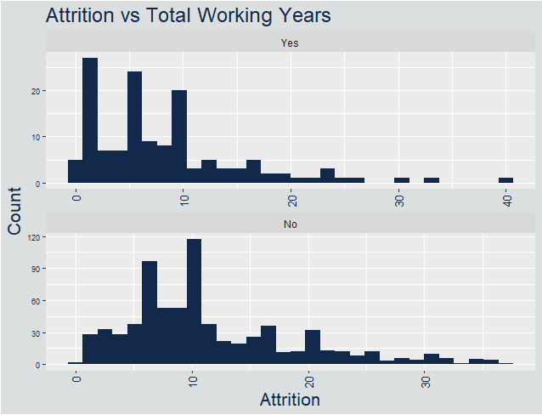
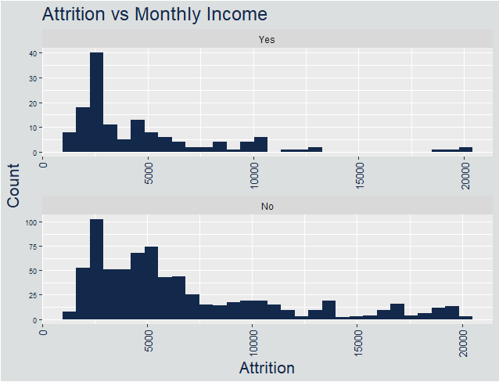
Variables related to attrition: Numeric
More people with few Total Working Years leave
Fewer people with higher Monthly Incomes leave

Slide 10
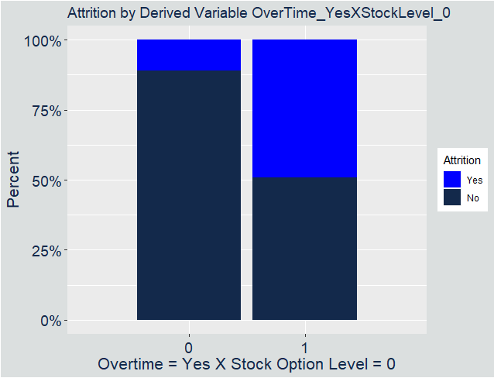
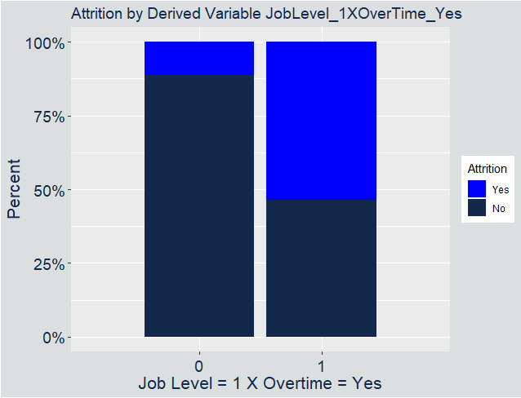
Variables related to attrition: derived
Create additional variables by One Hot Encoding and Variables Crosses
Many of these variables are very predictive

Slide 11
Testing attrition Models
Approach:
90% Data to Train, 10% to Test
Tested with 200 different combinations
“Passing” is getting Sensitivity and Specificity above 60%
Metric was Sensitivity + Specificity
Tests:
Test 1: Naïve Bayes – OverTime + JobInvolvement + TotalWorkingYears
Test 2: KNN - OverTime + JobInvolvement + TotalWorkingYears
Test 3: Naïve Bayes – 3 Derived Variables
Test 4: KNN – 3 Derived Variables
Test 5: Naïve Bayes – Several Variables
50 Variables, potential for over-fit
Test 6: KNN – Several Variables
Test 7: Naïve Bayes – Several (but less) Variables
Test | Metric | Variables | Passed
Test 1 | 1.082 | 3 | 0 %
Test 2 | 1.091 | 3 | 7 %
Test 3 | 1.409 | 3 | 28 %
Test 4 | 1.572 | 3 | 67.5 %
Test 5 | 1.661 | 50 | 97.5 %
Test 6 | 1.671 | 6 | 82 %
Test 7 | 1.529 | 9 | 80.5%

Slide 12
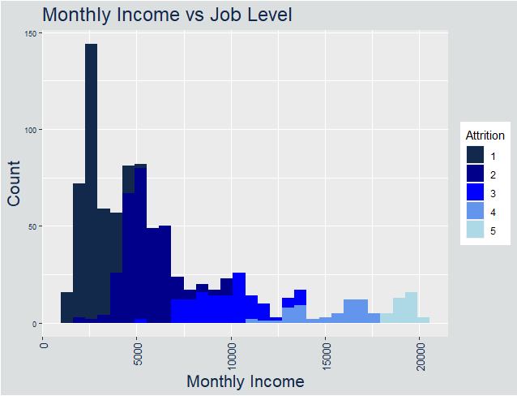
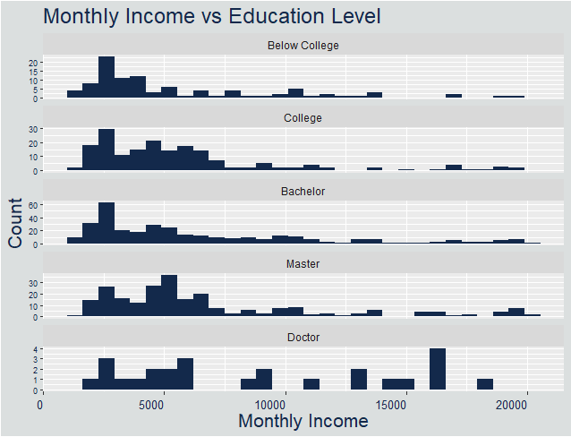
Variables related to monthly income: Categorical
Evidence of strong relationship between Monthly Income and Job Level
Not much evidence for relationship between Monthly Income and Education

Slide 13
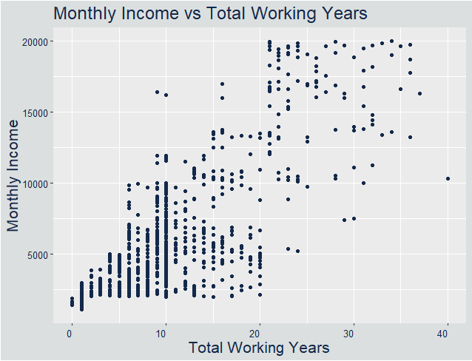
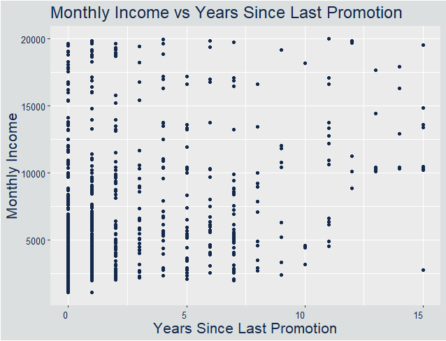
Variables related to monthly income: Numerical
Weak linear relationship with Total Working Years
Almost no relationship with Years Since Last Promotion

Slide 14
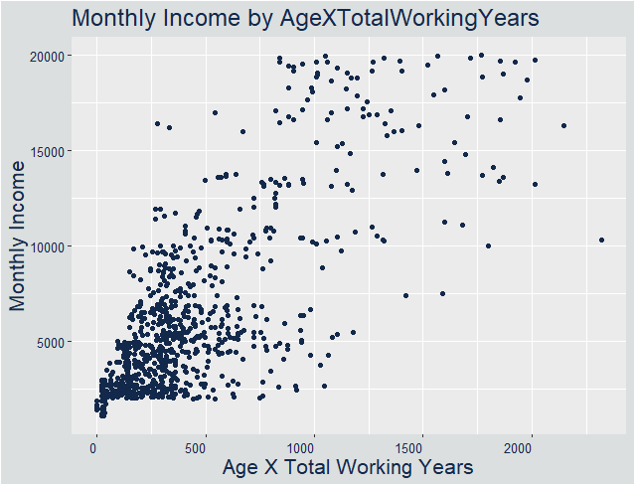
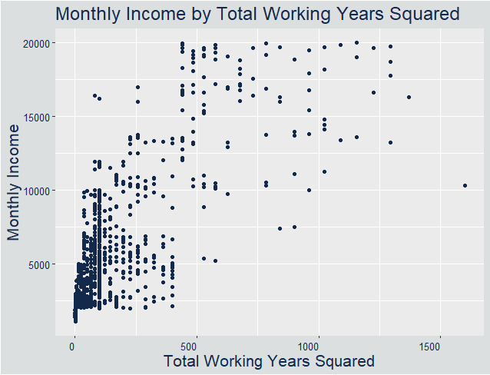
Variables related to monthly income: Derived
More Numeric Derived Variables were correlated to Monthly Income

Slide 15
Testing monthly income Models
Approach:
Similar approach as with Attrition Models
90% Data to Train, 10% to Test
Tested with 200 different combinations
“Passing” is getting RMSE below 3,000
Tests:
Test 1: JobLevel
Test 2: JobLevel + TotalWorkingYears
Test 3: JobLevel + TotalWorkingYears + Attrition
Test 4: JobLevel + TotalWorkingYears + AgeXTotalWorkingYears
Test 5: Several Variables
55 Variables, potential for over-fit
Test 6: Several (but less) Variables
Test | Variables | RMSE | Passed
Test 1 | 1 | 1262.0 | 100 %
Test 2 | 2 | 1255.4 | 100 %
Test 3 | 3 | 1255.3 | 100 %
Test 4 | 3 | 1254.8 | 100 %
Test 5 | 55 | 966.7 | 100 %
Test 6 | 10 | 1041.8 | 100%

Slide 16
Conclusion
EDA Performed
Models generated to predict Attrition and Monthly Income
Models perform well compared to metrics
Variable | Model | Variables | Desired Metric | Performed Metric | Passed
Attrition | KNN | 6 | 1.2 | 1.671 | 82 %
Monthly Income | Linear | 10 | 3000 | 1041.8 | 100 %

Slide 17
Thank you
Aaron Abromowitz
aabromowitz@gmail.com
www.linkedin.com/in/aaron-abromowitz-a30a5320
https://aabromowitz.github.io/

